Slide 1


Crafting the Research Statement
Jim Pawelczyk, Ph.D.
Noll Laboratory
Department of Kinesiology

Slide 2
Outline
What is a research statement?
Why do committees ask for them?
Types of requests
Essential elements
Best practices
What do committees look for in a statement?

Slide 3
What is a research statement?
A research statement is a summary of research achievements and a proposal for upcoming research. It includes BOTH current aims and findings AND future goals.
The statement will be useful to you and your potential employers. Write one NOW, before contemplating the job market. You’ll be refining it for the rest of your career!

Slide 4
Why do search committees request research statements?
To increase their confidence in YOU as a future colleague!
Potential employers expect you to have begun thinking about your research strategically (beyond your dissertation). The research statement tells
  what you have been doing recently and currently,
  in what direction you hope to go,
  how your research contributes to your field.
Along with your c.v., cover letter and letters of recommendation, it helps committees assess your
  areas of specialty,
  potential to get grants,
  academic ability,
  research needs,
  compatibility with the department or school.

Slide 5
Types of research statement requests
Type 1 - The “non request” request
“Please send curriculum vitae and three letters of recommendation to …”
Type 2 - Typical requests
“Applicants should submit a current curriculum vitae, a cover letter summarizing relevant experience, career interests and potential contributions to the Department, and the names and email addresses of three persons qualified to provide letters of reference …”
“To be considered, interested applicants should submit the following documents electronically: 1) a curriculum vitae; 2) a statement of research interests and accomplishments, and future research plans; and 3) a statement of teaching experience and/or description of the courses you are interested in teaching…”
Type 3 - The enhanced request
“Applications should include the following:
cover letter describing interests and qualifications for the position
curriculum vitae
reprints of three recent publications
brief (1-3 page) statement of the candidate’s 5-year research plan, which will be
evaluated for merit, feasibility, and synergy with other members of the [University] community.
name, address, and telephone number of three references”

Slide 6
Recipe for a research statement
Abstract
    Sometimes useful, not required
Background
    Research focused, not your life story
Current research
  Key results, importance, promising lines of inquiry
Research agenda (3-5 year)
    Short- and long-term goals, plans, and approaches
Relevance
    Employer and your Discipline and Society

Slide 7
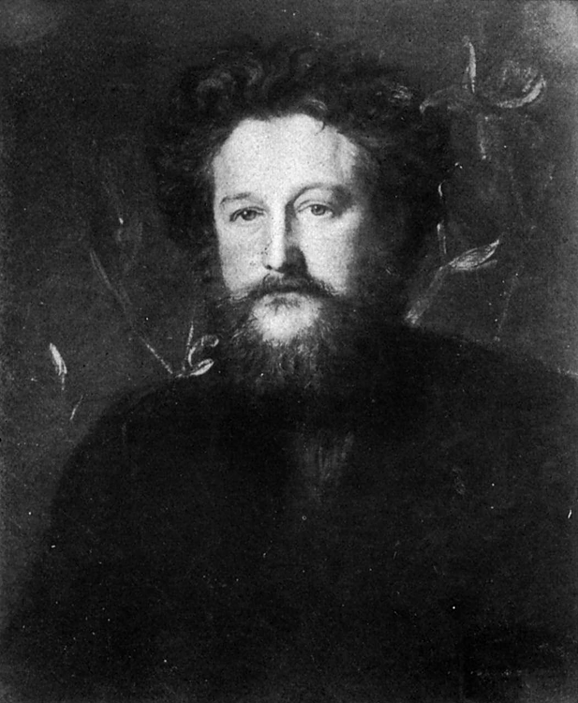
Crafting the best research statement
“Have nothing in your home that you do not know to be useful or believe to be beautiful.”
Follow the same principles for your research statement
William Morris
(1834-1896)
Father of the British Arts & Crafts movement

Slide 8
Crafting a useful statement -- Thoughts on content
Background & Relevance
  Give a context for your research interests
  Why does it matter?
Current & Planned research
  Communicate a sense that your research will follow logically from what you have done and that it will be different, important, and innovative

Slide 9
Crafting a useful statement –-
Make your content compelling
What excites you about your research? Sound fresh
Where appropriate, acknowledge the work of others
  Discuss, negotiate, and coordinate future research themes and strategies with your mentor(s)
Use language that shows you’ve begun to think of yourself as an independent researcher; knowledgeable about key issues in your area/field
  Your 3- to 5-year plan should be credible and specific (rather than detailed)
Identify funding organizations likely to support your research plans in a way that communicates your understanding of grantsmanship
  Briefly outline your proposal; one with broad enough goals that you can submit elsewhere if necessary

Slide 10
Crafting a beautiful statement -– style and formatting
Write as clearly and concisely as you can
Use headings (and subheadings), bullets, and white space for best effect
Electronic submission: check PDF formatting, be sure hard copies are appropriate for scanning
Aim for 2-3 pages in length; avoid page-long paragraphs
Get feedback from senior colleagues
Proofread!! Read your statement aloud … you’ll be surprised how many more improvements you’ll find!

Slide 11
To summarize, a well-crafted research statement is …
Brief
Clear
Succinct
Focused
Solid
Thoughtful
Readable
Creative
Pragmatic
Careful
Honest
Credible
Logical
Strategic
N.B. These adjectives describe the quality of the statement. The substance is up to you!

Slide 12
What do committees look for?
Your future direction FOCUS
Potential for funding INDEPENDENCE
Summary of accomplishments
Your fit with the unit
The resources you will need to be successful in your new job
That you think and communicate like a scientist
“The strongest research statements present a readable, compelling, and realistic research agenda that fits well with the needs, facilities, and goals of the department. Research statements can be weakened by overly ambitious proposals, by lack of clear direction, by lack of big-picture focus, or if inadequate attention is given to the needs and facilities of the department or position.”
Peter Fiske, in "The Truth about Teaching and Research Statements”

Slide 13
Helpful resources
Learn from your peers! There are many examples of research statements found online
ScienceCareers.org (excellent article!)
http://sciencecareers.sciencemag.org/career_development/
previous_issues/articles/1820/writing_a_research_plan
Peter Fiske, MIT - "The Truth about Teaching and Research Statements”
http://web.mit.edu/career/www/workshops/CV/statements.pdf
"How to Write an Effective Research Statement" (UPenn)
http://www.vpul.upenn.edu/careerservices/gradstud/
Writing_Research_Statement.ppt

